Slide 1
CGB1221-DATABASE MANAGEMENT SYSTEM
Department of Artificial Intelligence and Data Science
Academic Year: 2024 – 2025
Register Number : 2303811724321068
Name : Mohamed Ibrahim F
Year : II
Semester : IV
Section : B
Date : 02.06.2025

Slide 2
Title of the Project
HOSPITAL MANAGEMENT SYSTEM

Slide 3
Problem Identification
1. Hospitals manage a large volume of data, including the patient records , doctor details, appointments, billing, and inventory. Manual or inefficient systems.
2. Data inconsistency due to manual record-keeping and difficulty in accessing information quickly.

Slide 4
Objective
To develop an efficient hospital management system that digitizes patient records, doctor details, appointments, billing, and inventory to reduce data inconsistency and enable quick access to accurate information.
Efficient Data Management:
Automates the handling of patient records, doctor profiles, appointments, billing, and inventory
Reduces Human Errors:
Minimizes data inconsistencies caused by manual record-keeping.

Slide 5
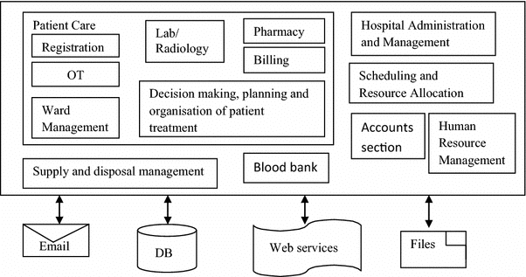
Proposed Architecture

Slide 6
List of Modules
Patient Management Module
Appointment Scheduling Module
Security Management Module
Access Control Module

Slide 7
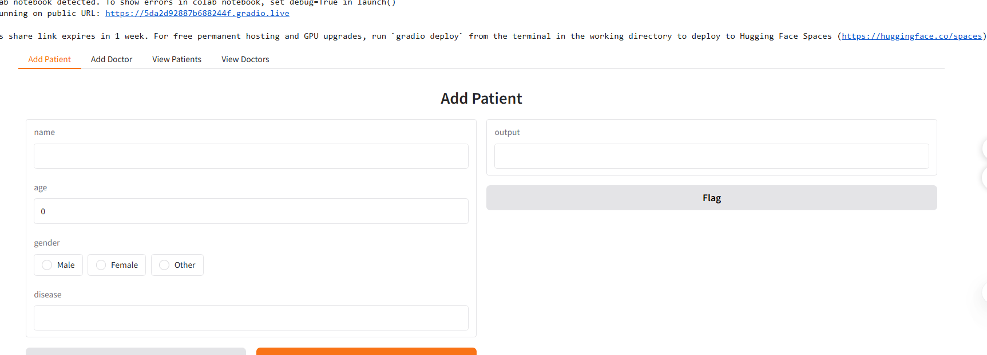
Module Description
1. Patient Management Module:
Register new patients and store personal details, Maintain medical history, diagnosis, and Prescriptions and Track admissions, discharges, and follow-ups.

Slide 8
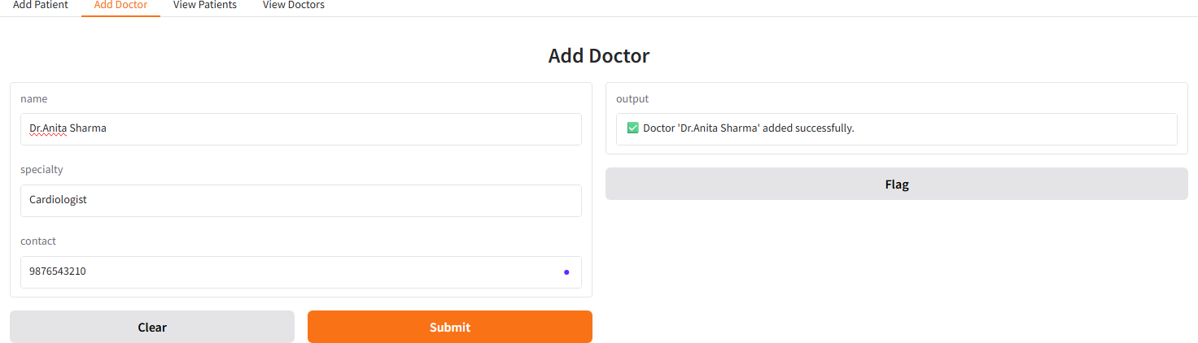
Module Description
2. Appointment Scheduling Module:
Patients can book, update, and cancel appointments .Doctors can accept or reject appointments .Send notifications for scheduled appointments,Role-based access control admin, doctors, nurses, and receptionists and analyze sensitive patient.

Slide 9
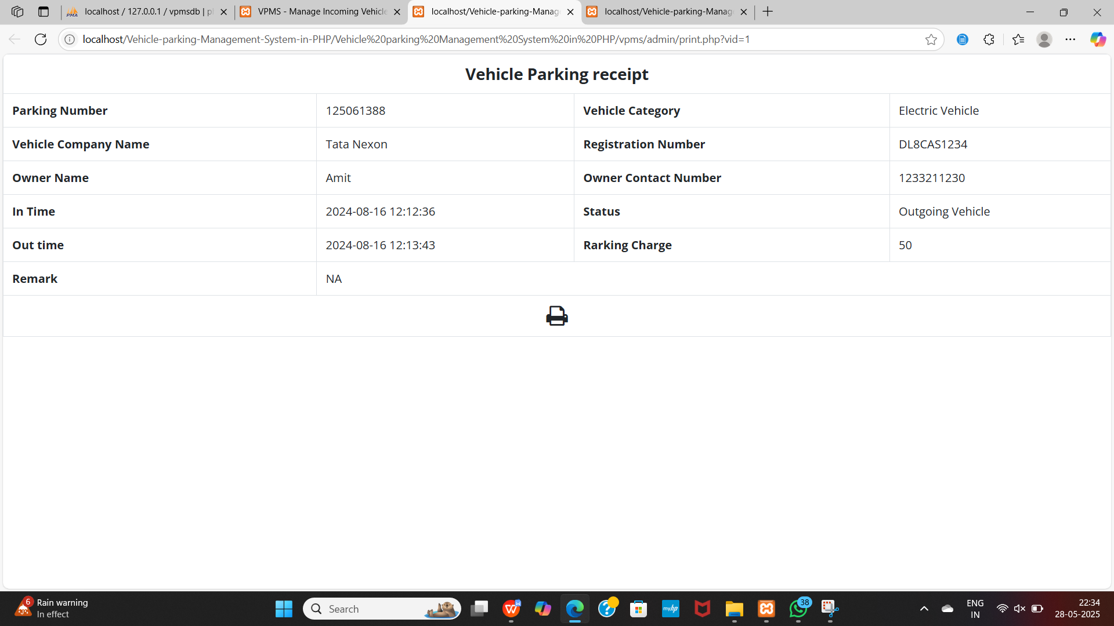
Module Description (Cont..)
Parking Fee Calculation & Payment Module: This module calculates parking charges based on duration and predefined rates, ensuring transparent billing. It processes payments through various methods and maintains transaction records for financial accuracy.

Slide 10
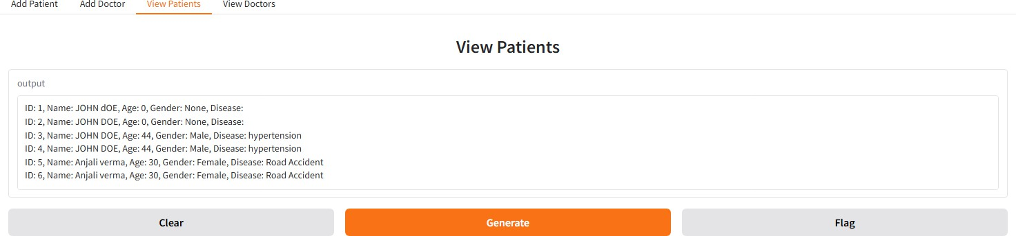
Module Description (Cont..)
3.Access Control Modules:
Fine-grained access controls are applied to ensure that only authorized users can access specific records. For instance, only the assigned doctor and the concerned patient may view a particular treatment history.

Slide 11
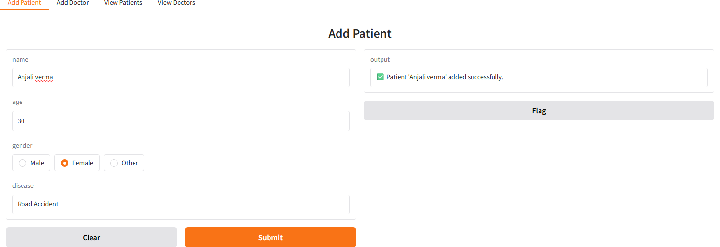
Results

Slide 12
Results

Slide 13
Conclusion
The Hospital Management System (HMS) developed as part of this DBMS project aims to streamline and digitize core hospital operations such as patient registration, appointment scheduling, medical record management, billing, and access control.

Slide 14
Advantages
Integration with IoT and Wearable Devices
Mobile Application Support
AI-Based Diagnosis Support
Telemedicine Module
Multi-language and Accessibility Support
Advanced Analytics and Reporting

Slide 15
Thank You
Any queries???

